Slide 1
The physical effects of abuse
Recognizing the Signs and Moving Towards Healing

Slide 2
Mind, Body, Spirit
MIND
BODY
SPIRIT
Notes:
We were created in God’s image: Genesis 1:26 Then God said, “Let Us make man in Our image, according to Our likeness…
Like the Trinity, Father, Son, and Holy Spirit… we are three in one, mind, body, and spirit. They are inseparable and what effects one effects the other.
No matter how much we attend to our spirit with prayer, worship, scripture, etc. our spirit will still be effected if our mind and body are being abused.
When the mind and/or spirit are abused our body is effected.
When the body is abused the mind will be effected.
I’m going to focus on the physical effects of all forms of abuse. As I am talking about this, some things may be triggering and you may need to take a break and step out, that is understood do not be afraid to take a few minutes if needed.

Slide 3
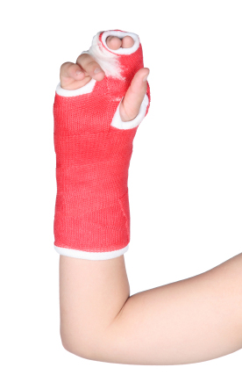
Physical effects of abuse
Physical abuse
*Broken bones- especially ribs and arms, nose
*Dislocations, head, eye and dental injury
*Bruises- often on more hidden parts of the body like the trunk and thighs
*Internal organ injury
*Burns- most common cigarette
*Scratches, bald patches, unusual weight loss from food restriction, evidence of withholding of medical care

Slide 4
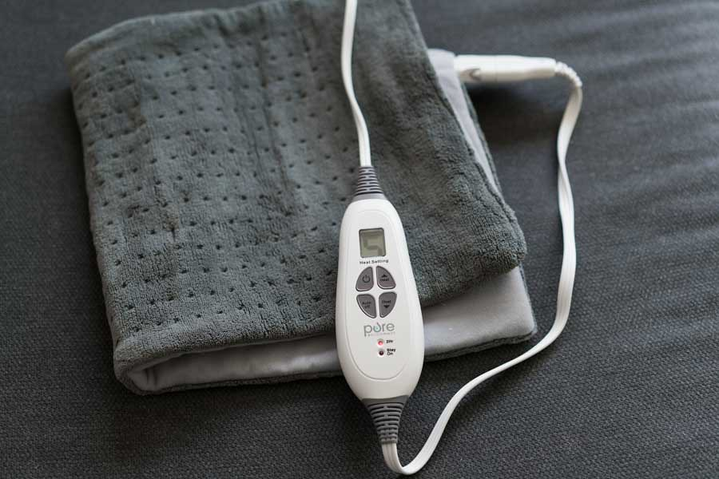
Physical effects of abuse
Sexual abuse
*Pain with intercourse
*Chronic pelvic pain
*Painful periods
*Sexually transmitted disease exposure
*Pain with bowel movements
*Frequent urinary tract infections
*Vaginal cuts, bruising, infection
*Irregular periods
*Infertility and pregnancy loss

Slide 5
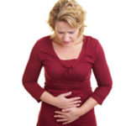
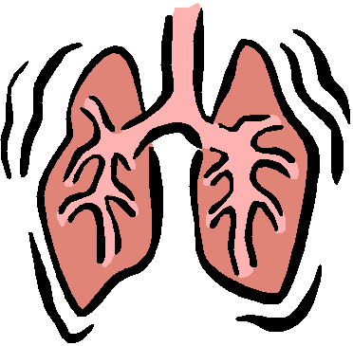
Physical effects of abuse
Emotional/spiritual abuse
*Gut- abdominal pain, nausea, vomiting, diarrhea, irritable bowel syndrome, inflammatory bowel disease, easy fullness
*Frequent or prolonged infections- viral illness that lasts weeks not days, chronic sinus or skin infection
*Respiratory- hard to control
asthma and allergies, unexplained
cough, shortness of breath
Notes:
Keep in mind these symptoms can be present for multiple reasons but are found more frequently in the abused population than the non-abused
Half the time the abuser is getting his power fix by acting like the hero and forcing you to do what they have deemed is necessary for your wellness, the other half they are the martyr that is sacrificing all because you are always sick and they keep you feeling more guilty and oppressed. Worsens trauma bonding.

Slide 6

Physical effects of abuse
Emotional/spiritual abuse
*Neurologic- chronic headaches and migraines, dizziness, loss of balance and falls, confusion, brain fog/forgetfulness, numbness, multiple sclerosis, insomnia, clumsiness
*Heart- palpitations, abnormal heart rate, difficulty regulating blood pressure, heart attack, fainting
*Reproductive- lack of interest, difficulty or inability to orgasm, impotence, irregular periods, infertility, painful periods
Notes:
Neurologic- we all do it from time to time but it is excessive when in a toxic environment. give examples of CRS. Empowers the abuser all the more- see u couldn’t remember anything if it weren’t for me, you couldn’t make it without me. And the abused is so frightened by their own loss of brain function that they believe the lies. But the whole time it’s the abuse causing it!

Slide 7
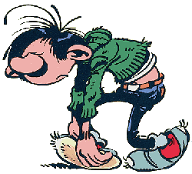
Physical effects of abuse
Emotional/spiritual abuse
*Urinary- frequency, urgency, bladder pain without infection, interstitial cystitis
*General- exhaustion, chronic fatigue syndrome, muscle pain and spasm,
joint pain and swelling, excessive
weight gain or loss, easy bruising, hypothyroidism, abnormal glucose
*Psychiatric- depression, anxiety, panic attacks, nightmares, post traumatic stress syndrome, impulsivity, cravings/addiction
Notes:
Neurologic- we all do it from time to time but it is excessive when in a toxic environment. give examples of CRS. Empowers the abuser all the more- see u couldn’t remember anything if it weren’t for me, you couldn’t make it without me. And the abused is so frightened by their own loss of brain function that they believe the lies. But the whole time it’s the abuse causing it!

Slide 8
How non-physcial abuse effects the body
It is NOT
“in your head”!
It IS
in your body!

Slide 9
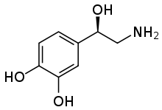
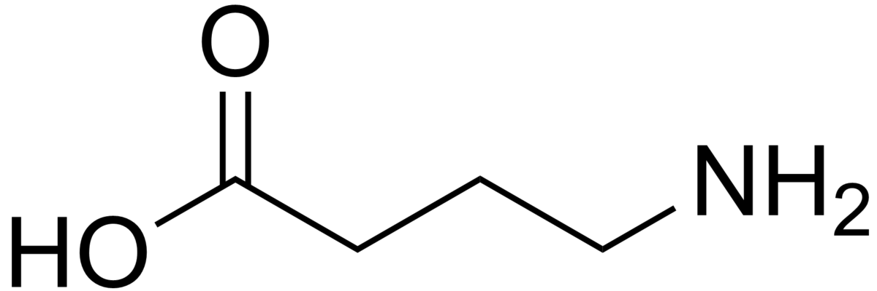
How non-physcial abuse effects the body
*Uses up essential neurotransmitters like norepinephrine, serotonin, dopamine, and GABA- essential for mood, but also essential for:
-bowel and gut function
-memory
-energy
-appetite
-sex drive
-blood clot formation
-pain regulation
Notes:
Neurotransmitter is a fancy word for nerve effecting hormone

Slide 10
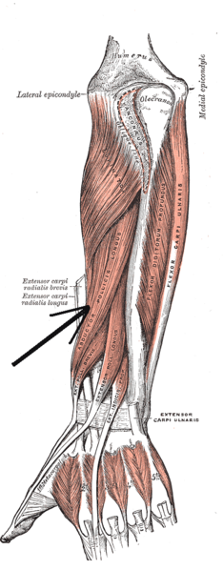
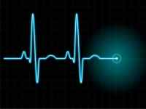
How non-physcial abuse effects the body
*Uses up essential neurotransmitters like norepinephrine, serotonin, dopamine, and GABA- essential for mood, but also essential for:
-body coordination
-heart rate and blood pressure regulation
-glucose regulation
-bladder function
-blood flow to muscles
-wound/infection healing

Slide 11
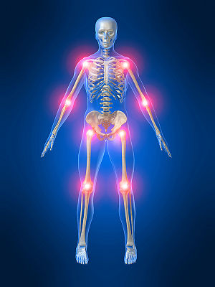
How non-physcial abuse effects the body
*Releases inflammatory hormones like histamine and leukotriene
-worsens allergies/asthma
-inhibits healing wounds/infection
-causes pain and swelling
-causes headaches and fatigue
-further uses up your neurotransmitters
-stresses the adrenal glands further

Slide 12
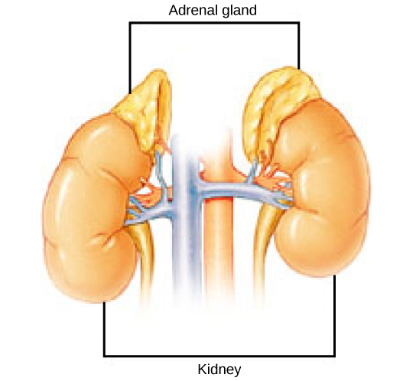
How non-physcial abuse effects the body
*Stresses the adrenal glands
-adrenal overfunction or fatigue
-body temperature regulation
-fluid balancing, swelling, puffiness
-blood pressure, heart rate regulation
-depression, anxiety, memory, focus
-thyroid dysfunction (not hypothyroidism, same symptoms but reversible)
-metabolism and weight, hunger, food cravings, glucose regulation
-period regulation, fertility, PMS, menopause symptoms, libido

Slide 13

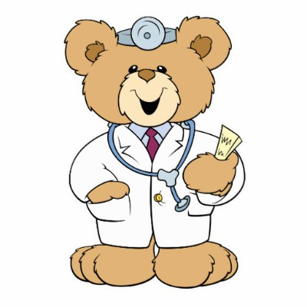
Healing
First things first
*If you are still at home make a safety plan
*Find a counselor experienced with domestic violence, abuse, and trauma
*Find a doctor that can help heal your body by listening to your story and treating you compassionately
*Find a good church that understands domestic violence and spiritual abuse, one that will not use scripture to oppress but to love
*Be open and honest with yourself, your counselor, your physician, and your pastor
Notes:
Use resources like called to peace ministries, your local shelter, InterAct, etc for ideas and names of people that they have knowledge of.
You must take the time to take care of yourself or you won’t be able to do your job as well whether its to take care of others or run a business.

Slide 14
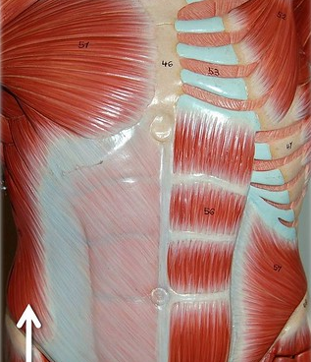
Healing
First things first
*To borrow from Leslie Vernick, work on your CORE…
-Commited to truth and reality
-Open to the Holy Spirit and others
-Responsible for you and Respectful
-Empathetic but not Enabling

Slide 15
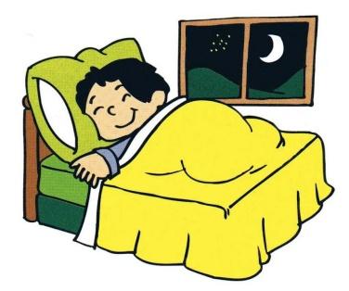
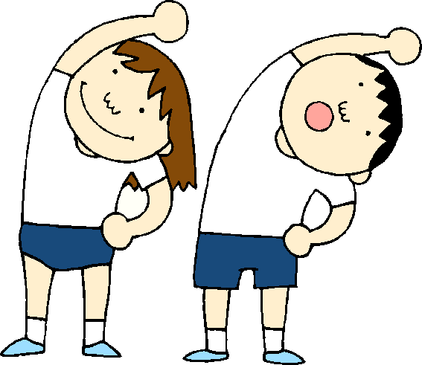
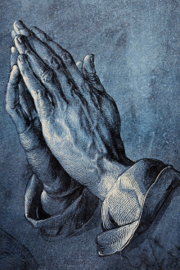
Healing
Behavioral Changes
*Sleep at least 8 hours every night- even if the dishes have to wait until morning
*Exercise daily- light to moderate
*Avoid toxins in your environment-
including toxic people
*Daily mindfulness and meditation-
at least 5-10 minutes daily
*Support your spirit- read the Word
(Psalms is especially helpful), pray,
listen to worship
Notes:
Avoiding toxins may mean leaving your situation if God so leads you, but you must be sure to do it safely

Slide 16
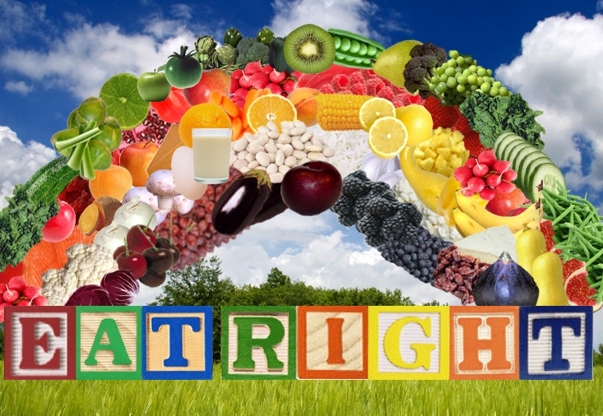
Healing
Behavioral Changes
*Nutritional balance- avoid
sugar, limit gluten, get plenty
of fresh fruits and vegetables,
ensure adequate healthy
protein sources, drink plenty
of water
*Do not skip meals
*Avoid self medicating with alcohol, drugs, misuse of prescription drugs or use of other people’s medication
Notes:
It is important to maintain normal sugar and protein levels as you are healing your body.
If medication is needed for sleep, depression, anxiety, etc. please see your doctor

Slide 17
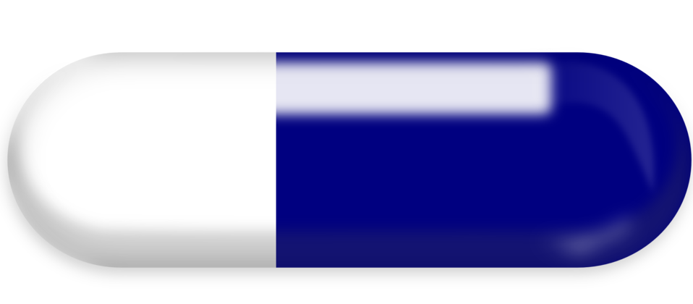
Healing-Supplements
Always consult a physician first
*Adrenal support- ashwagandha (but not if major autoimmune illness), rhodiola, schisandra berry, holy basil, vitamin a, vitamin c, methylated B12 and folate, bovine adrenal gland
*Adrenal calming- relora or magnolia bark, phenibut, L-theanine or GABA, ashwagandha, magnesium, CBD oil has helped some patients
*Serotonin support- 5HTP, tyrosine, SAMe, methylated B12 and folate
Notes:
Cbd disclaimer

Slide 18
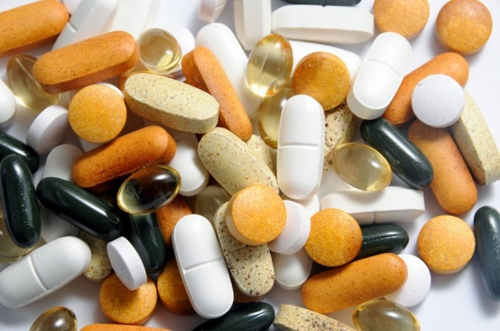
Healing-Supplements
Always consult a physician first
*GABA support- L-theanine, methylated B12 and folate, some have done well with CBD oil
*Histamine help- SAMe, quercetin, stinging nettles
*Anti-inflammatories- curcumin/turmeric, ginger, bioflavones, hops, cinnamon, boswellia (also known as frankincense), CBD oil has helped some patients

Slide 19
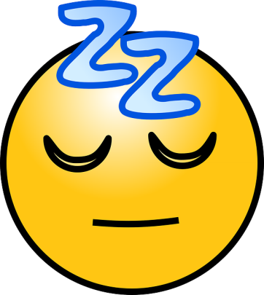
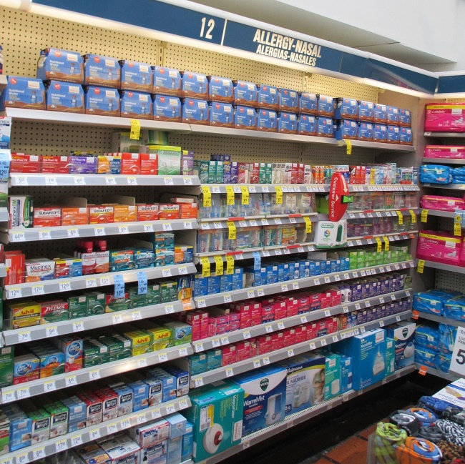
Healing
Over the Counters
*For pain, swelling, headaches- occasional ibuprofen or naproxyn
*Allergies- tablets of cetirizine, fexofenadine, loratidine; nasal sprays of fluticasone, budesonide, and/or cromolyn
*Sleep aid- diphenhydramine,
doxylamine, melatonin
*Diarrhea- loperamide

Slide 20


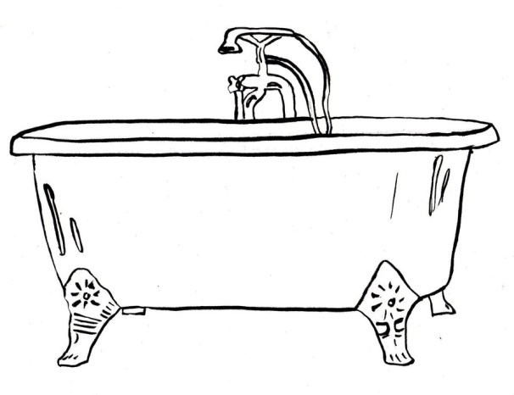
Healing
OTCs
*Heart burn- chewable calcium and magnesium, ranitidine, famotidine, cimetidine; avoid pantoprazole, omeprazole, or esomeprazole for long term use
*Muscle ache- epsom salt baths
*Fatigue and focus-
1-2 cups coffee per
day maximum

Slide 21
Healing-Prescriptions
When more is needed
*Antidepressants- can also help for the non-mood symptoms that the body is having
*Anti-inflammatories- for a limited time
preferably, helpful for pretreatment
monthly for menstrual pain
*Migraine prevention medications
*Heart rate controllers- can also help anxiety
*Appetite modulators- up or down
*Irritable bowel medications that regulate gut function

Slide 22
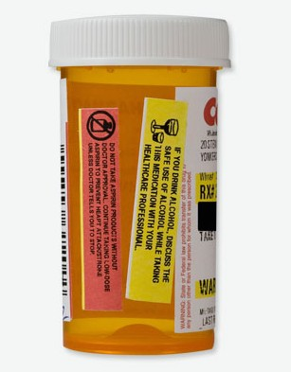
Healing-Prescriptions
When more is needed
*Bioidentical hormonal therapy-
helpful with PMS and peri or post menopause
*Naltrexone- regular dose or low dose depending on target of treatment
*Thyroid support- for thyroid dysfunction (will be tough to find physician who treats this portion)
*Sleep medication- limited dose and time preferred
Notes:
Sleep med risks in abuse situations

